Slide 1


ECE449 Project 8: Referring Multi-Object Tracking with Domain Adaptation
Group 9 Jie Wang, Mingchen Li, Junjie Ren, Haoxuan Du 12/25/2023
Course Supervisor: Prof. Gaoang Wang

Slide 2
RMOT: Referring Multi-Object Tracking
An advanced computer vision technique, SOTA of 2023 MOT
Combines language processing with visual data to track multiple objects in video sequences
Interprets linguistic descriptions or commands to identify and follow specific objects across frames, enhancing tracking precision and applicability in complex scenarios like autonomous driving and surveillance.

Slide 3
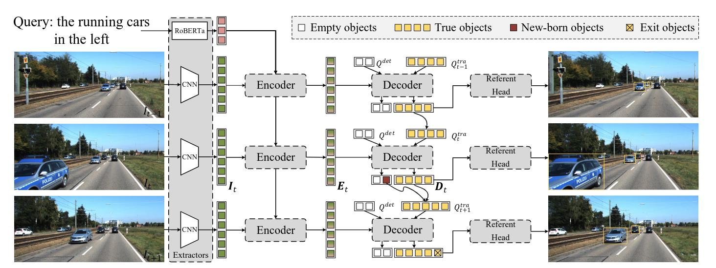
RMOT: Referring Multi-Object Tracking
Architecture Analysis of ‘transrmot.py’

Slide 4
Problem Classification
1. Use the 15 videos in the refer-KITTI data set with serial numbers 01, 02, 03, 04, 06, 07, 08, 09, 10, 12, and 14 as the training set. The remaining data sets are merged with the test set (05, 11, 13) as a new test set.
2. Retrain RMOT on the new training set and test on the new test set.
3. Use a language model (RoBERTa, or other multi-modal models such as CLIP) to train on the test set and complete two multi-object tracking tasks:
(1) Given only the ground truth of the box, design the loss function for the use the language encoder and test it on the new test set;

Slide 5
Problem Classification
1. Use the 15 videos in the refer-KITTI data set with serial numbers 01, 02, 03, 04, 06, 07, 08, 09, 10, 12, and 14 as the training set. The remaining data sets are merged with the test set (05, 11, 13) as a new test set.
2. Retrain RMOT on the new training set and test on the new test set.
3. Use a language model (RoBERTa, or other multi-modal models such as CLIP) to train on the test set and complete two multi-object tracking tasks:
(2) Without given the ground truth of the box and ID, use the pre-training weights of DETR (following RMOT) to generate box proposals as pseudo labels, use the language model to design the loss function and test it on the test set.
(To be done in the final report)

Slide 6
Progress Update
Successful deployment of RMOT,
Preparation for retraining,
Integration of the CLIP model,

Slide 7
Target File (transrmot.py) Modifications
Components to Replace: Please see the jupyter notebook
Handling Hugging Face and GFW Issues:
Share insights on network strategies learned while dealing with Hugging Face under GFW constraints.

Slide 8
AutoDL Server: an Online Platform
Access to Powerful Hardware: offers remote access to powerful GPUs and CPUs, facilitating deep learning tasks based on their project needs.
Flexible Environment: supports a wide range of deep learning frameworks and tools, such as TensorFlow, PyTorch, and Keras.
Remote Accessibility & Collaboration Friendly: Facilitates sharing of resources and collaboration among team
Notes:
AutoDL is an online platform that provides cloud-based deep learning development environments. It's designed to offer researchers and developers easy access to powerful computational resources for training and deploying deep learning models.
- **Access to Powerful Hardware**: offers remote access to powerful GPUs and CPUs, facilitating deep learning tasks based on their project needs.
- **Flexible Environment**: supports a wide range of deep learning frameworks and tools, such as TensorFlow, PyTorch, and Keras.
- **Remote Accessibility & Collaboration Friendly**: Facilitates sharing of resources and collaboration among team members.

Slide 9
AutoDL Server: Challenges Faced
Problem 1: Lack of funds, running on multiple cards very expensive.
Strategy: Save money by using a single 2080Ti card to run a simpler portion of the data to see if it can converge.
Problem 2: Initially unfamiliar using this platform.
Strategy: Generate an SSH key and connect via Visual Studio Code.

Slide 10
KITTI MOT Tracking Dataset
Diverse Data Sources: camera views, 3D laser scans, location and movement data, camera calibration matrices
Real-World Driving Scenes
Object Tracking Benchmark
Labeling Process: detailed annotations
Evaluation Metrics: HOTA (Higher Order Tracking Accuracy), CLEAR MOT, and MT/PT/ML (Mostly-Tracked/Partly-Tracked/Mostly-Lost)
Notes:
The KITTI dataset is a renowned and comprehensive dataset used primarily for evaluating computer vision tasks in the context of autonomous driving.

Slide 11
Language Model Component
Language Interpretation
Feature Extraction and Embedding
Synergy with Visual Tracking
Enhanced Precision
Flexibility
Notes:
Language Interpretation: LMC processes natural language inputs, such as descriptions or commands, to extract relevant information about the objects to be tracked in video sequences.
Feature Extraction and Embedding: It converts textual data into a machine-readable format, often through the generation of word vectors or embeddings. This transformation allows the system to match linguistic descriptions with visual elements.
Synergy with Visual Tracking: LMC's output is integrated with RMOT's visual processing components. This integration enables the system to identify and follow specific objects in video frames based on the language input, enhancing the tracking accuracy and applicability in complex scenarios.
Enhanced Precision: By understanding contextual language cues, LMC allows RMOT systems to track objects more precisely based on descriptions.
Flexibility: LMC enables RMOT systems to handle a wide range of linguistic inputs, making them adaptable to various applications like autonomous driving, surveillance, and interactive video analysis.

Slide 12
Language Model Component Model Demonstration
Data Evaluation
Video Demonstration
Notes:
Model Demonstration: Show our current RMOT model in action.
Data Evaluation: Assess and present the performance metrics.
Video Demonstration: Show video annotations made by the original model and also ours, including live or pre-recorded demonstrations.

Slide 13
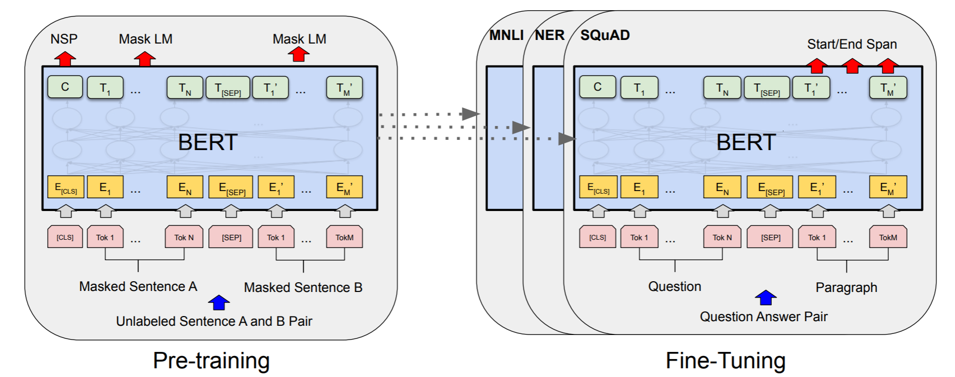
Intro to RoBERTa
Improvement based on BERT

Slide 14
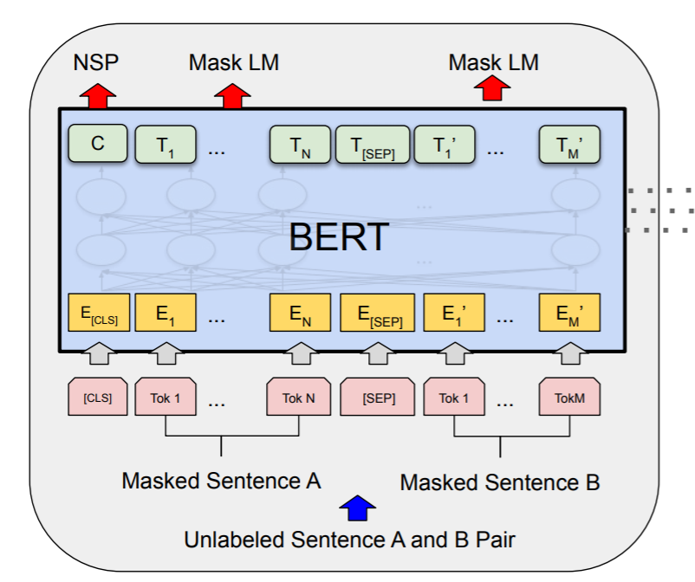
RoBERTa: Application in RMOT
In RMOT, we need a feature vector
for each lemma in the sentence
Taking a sentence of length l as input,
we get a tensor of size l×D
(D is the feature dimension of word
vectors)

Slide 15
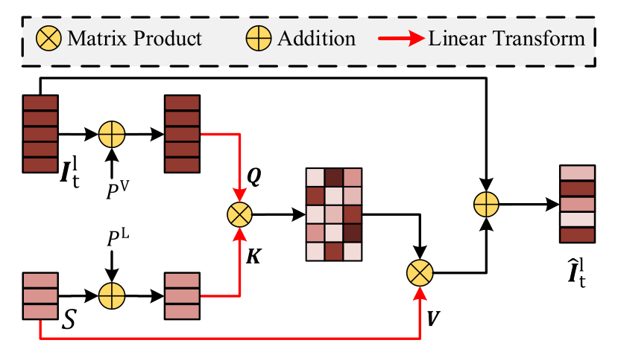
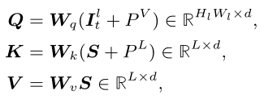
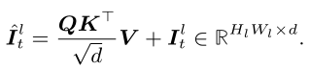
Cross-modal Encoder
How are multiple modalities encoded?
The early-fusion module:
the parameters in RoBERTa
are frozen during training
(QK/sqrt(d))V

Slide 16
Cross-modal Encoder
Following this line of thought, any language model capable of generating a word vector for each token can replace RoBERTa.
This way, we won't need to modify the early-fusion module.
Note: The authors of the paper have essentially tried all the suitable class-Bert models, and RoBERTa performed the best. We feel there's no significant need to experiment with other text2text models, as we only require the encoder, not the decoder.

Slide 17
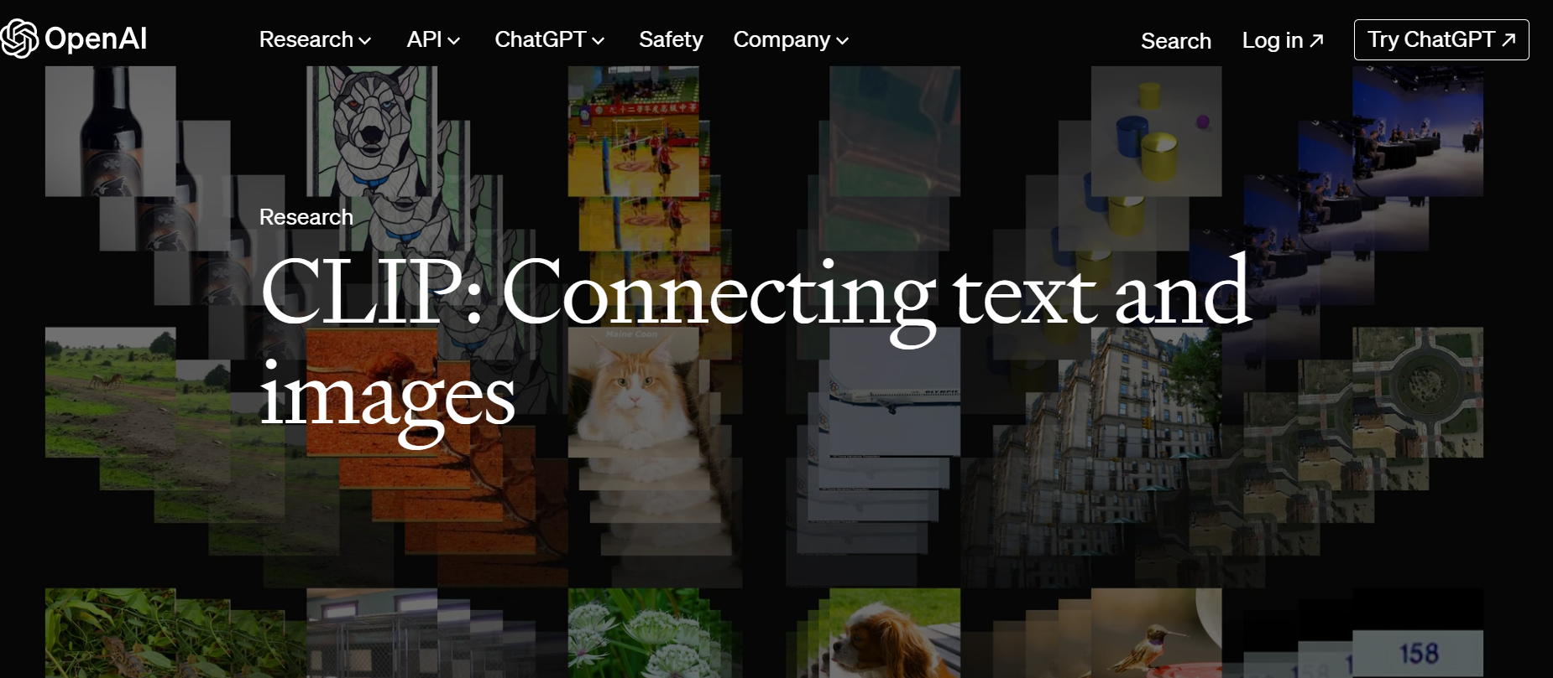
Contrastive Language-Image Pre-Training (CLIP)

Slide 18

The motivation for integrating CLIP into the RMOT framework
To enhance its cross-modality capabilities, particularly in challenging scenarios where traditional analysis may fall short.
CLIP can understand Image and turn into text
Application Scenario: Police Chasing Vehicle
For instance, license plate recognition may be hindered due to pixelation or other visual obstructions. However, CLIP can recognize vehicle types and potentially even make brand-specific identifications based on visual cues alone.
draw an image of the police chasing vehicle with mot help

Slide 19
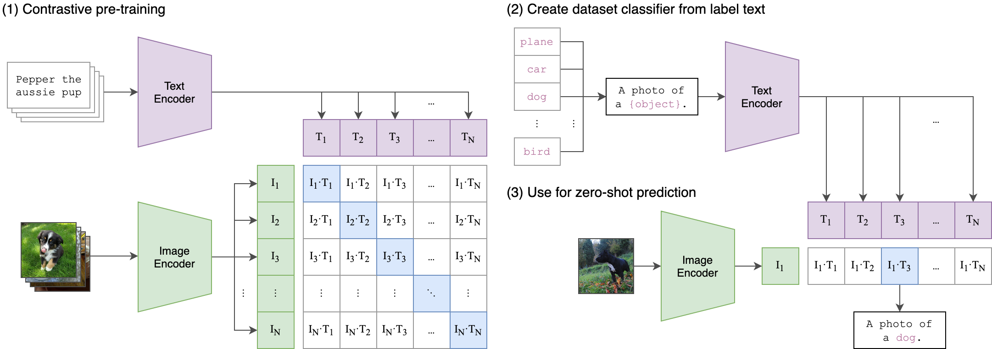
Contrastive Language-Image Pre-Training (CLIP)
Dual Processing
Rich Embeddings
Versatile Applications
The expression query refers to multiple objects of interest, which is fed into the encoder along with the video stream, and the RMOT outputs a tracking box corresponding to the query.
The key words in language query of Referring Multi-Object Tracking include color, position, motion state, target object and so on.
Notes:
Dual Processing: CLIP is designed to handle both text and image data efficiently. It uses a vision transformer to analyze images and a separate transformer-based language model for text.
Rich Embeddings: When given text or images, CLIP generates rich embeddings that capture a deep understanding of both modalities. These embeddings are then used for various comparison and classification tasks.
Versatile Applications: Beyond standard image classification tasks, CLIP is effective in more complex scenarios like object detection, zero-shot learning, and multimodal tasks where understanding the context from both text and image is crucial.

Slide 21
Contrastive Language-Image Pre-Training (CLIP)
Dual Processing
Rich Embeddings
Versatile Applications
Color category includes white, red, blue, green, yellow, and so on. Position category is comprised of left and right. Motion state consists of turning, parking, and moving. Target objects are cars, vehicles, pedestrian, or others.
Notes:
Dual Processing: CLIP is designed to handle both text and image data efficiently. It uses a vision transformer to analyze images and a separate transformer-based language model for text.
Rich Embeddings: When given text or images, CLIP generates rich embeddings that capture a deep understanding of both modalities. These embeddings are then used for various comparison and classification tasks.
Versatile Applications: Beyond standard image classification tasks, CLIP is effective in more complex scenarios like object detection, zero-shot learning, and multimodal tasks where understanding the context from both text and image is crucial.

Slide 22
Contrastive Language-Image Pre-Training (CLIP)
Enhancing Language Model Component
Improving Accuracy and Efficiency
Broadening Applicability

Slide 23
The End
Thank you for listening, Q&A time.
ECE449: Machine Learning Presentation

